Slide 1
Melbourne Property analysis
Ali Yazdan
Asal Valisoltani
Ray Jong
Kylie Collins

Slide 2
aGENDA
INTRODUCTION
Ali
CLEANING DATA
Asal
VISUALISATIONS
Ray and Kylie
FINDINGS, CONCLUSIONS
Ali
Notes:
2.5 MINUTES EACH

Slide 3
iNTRODUCTION
Lottery winner won $1 million to buy large family home
Budget $800k - $1m
Family of 4: husband and 2 children
Works in CBD
Free standing home, 4 BR, 2 garage, large.
Compare different Victorian regions re price, distance to CBD, schools, shopping, transport
Purpose: to use data to inform her investment decision
Notes:
A Lottery winner, in her 40s, has won $1M and would like to invest it in her dream family home. She has 2 teenage children, a daughter and a son, who enjoy their own privacy and would love to have a place big enough to invite friends over. Both herself and her husband work in the Melbourne CBD and they own 1 car. Considering that this $1M will be her only substantial income enough to make her dream home come true, she has decided to approach our Buyer’s Advocate firm in order to make the most informed decision for herself and her family. The client has also expressed her preference that if she would be able to find the perfect home below $1M, it would help her to upgrade her car and to buy a second one.

Slide 4
Cleaning and Sorting data

Slide 6
VISUALISATIONS

Slide 8
Land size vs distance from cbd

Slide 9
Median age per region

Slide 10
Median bedrooms per region

Slide 11
Proportion of regions with properties sold $800k-$1m

Slide 12
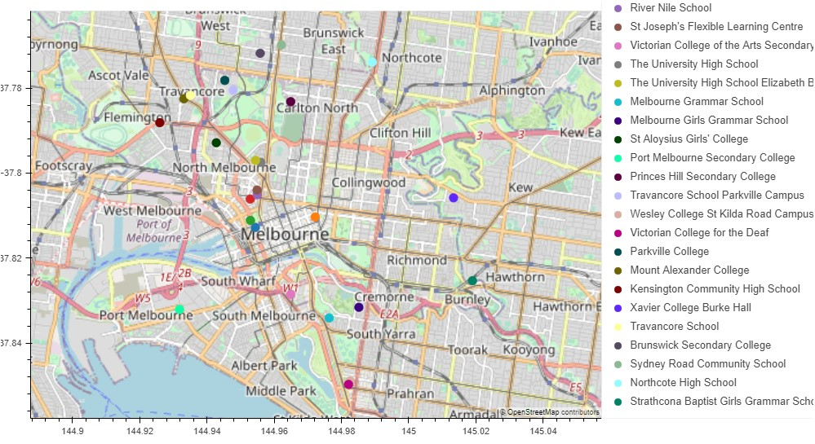
School map

Slide 13
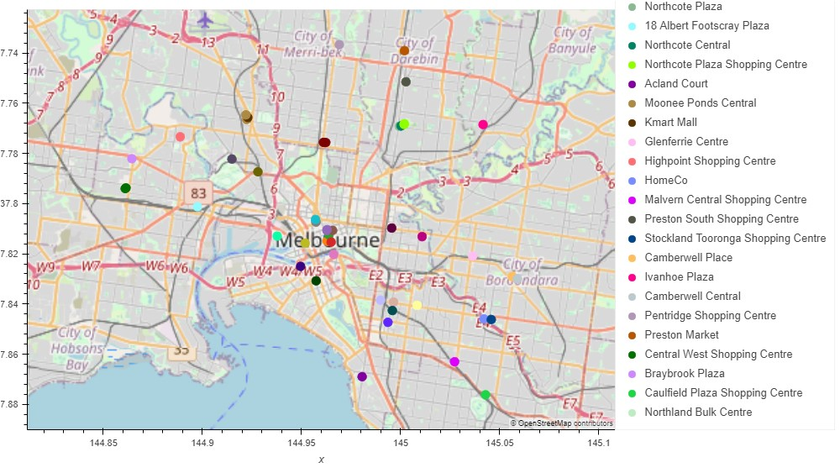
Shopping map

Slide 14
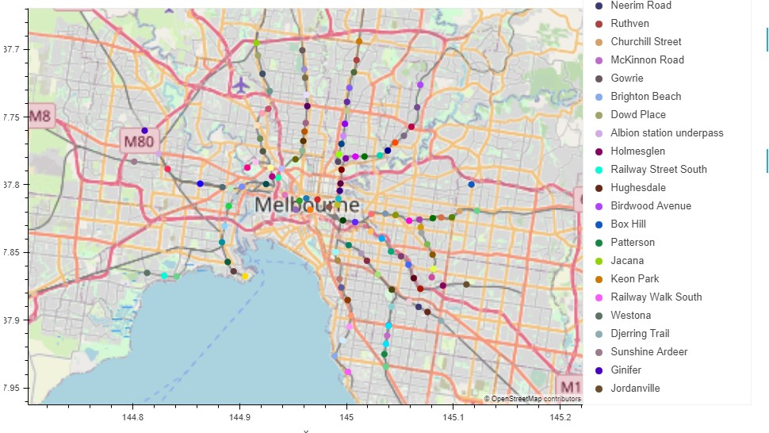
transport map

Slide 15
Findings, conclusions
Ali can you fill this in?

